Slide 1

WELCOME
Virtual CPE meeting on
RERA

Slide 2


THE INSTITUTE OF
CHARTERED ACCOUNTANTS OF INDIA
Setup by an Act of Parliament
KOZHIKODE BRANCH
On 19th Sep 2020 at 10.00 AM

Slide 3
OBJECTIVES - RERA
Ensure accountability towards allottees and protect their interest;
Infuse transparency, ensure fair play and reduce frauds & delays;
Introduce professionalism and pan India standardization;
Establish symmetry of information between the promoter and allottee;
Imposing certain responsibilities on both promoter and allottees;
Establish regulatory oversight mechanism to enforce contracts;
Establish fast track dispute resolution mechanism;
Promote good governance in the sector which in turn would create investor confidence

Slide 4
BACKGROUND
Requirement of regulation of Real Estate Sector
Enactment of The Real Estate (Regulation and Development) Act 2016
Notification of Rules & Regulations by States.
Ministry -Ministry of Housing and Urban Poverty Alleviation

Slide 5
ENACTMENT OF RERA
the bill got approval of the Rajya Sabha on 10 March 2016 and by the Lok Sabha on 15 March 2016;
by Act 16 of 2016 dt: 26/03/2016, The Real Estate (Regulation & Development) Act 2016, came into force with effect from 01/05/2016;
69 out of 92 sections viz., Section 2, Sections 20 to 39, Sections 41 to 58, Sections 71 to 78 & Sections 81 to 92, came into force from 01/05/2016.
the remaining sections have come into force on 01/05/2017.

Slide 6
Preamble and Structure
Long Title
Structure
An Act to:
Act has 92 sections divided into
10 chapters as below:
establish Real Estate Regulatory Authority for regulation/ promotion of RE sector
Chapter I Preliminary Section 1 – 2
Chapter II
Reg of RE Projects and RE Agents Section 3 – 10
Chapter III Functions and Duties of Promoter Section 11 – 18
ensure sale of plot, apartment, building, RE
project in an efficient/ transparent manner
Chapter IV Rights and Duties of Allottees
Section 19
Chapter V
The Real Estate Regulatory Authority Section 20 – 40
Chapter VI Central Advisory Council
Section 41 - 42
protect the interest of consumers in the RE sector
establish an adjudicating mechanism for speedy dispute redressal
Chapter VII The Real Estate Appellate Tribunal Section 43 – 58
Chapter VIII Offences, Penalties and Adjudication Section 59 – 72
Chapter IX Finance, Accounts, Audit and Reports Section 73 – 78
establish the Appellate Tribunal to hear appeals from decisions, directions or orders of the Real Estate Regulatory Authority
for matters connected therewith or incidental thereto
Chapter X Miscellaneous Section 79 – 92
*Section 89: Act to have an overriding effect

Slide 7
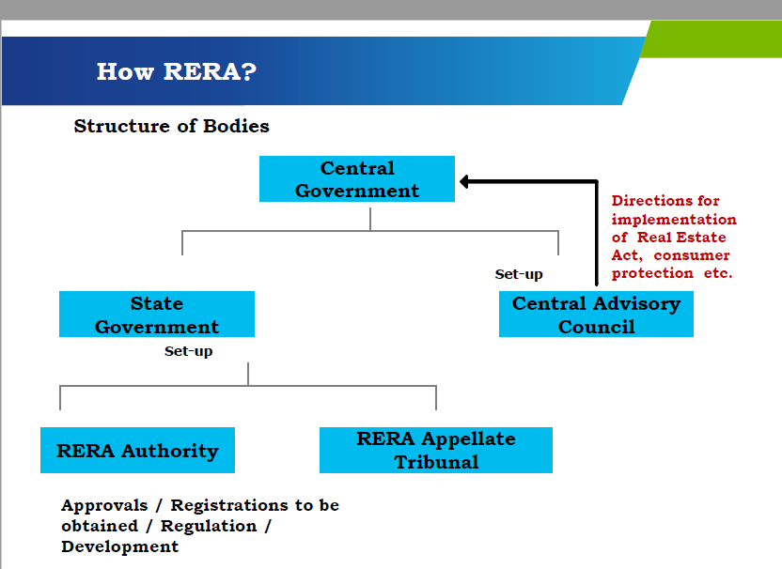

Slide 8
RERA Changes
Promoter – Increased responsibility & compliances
Liquidity – Cash flow planning
Registration – Project registration with RERA
Sales & Marketing – Increase in project launch time
Operational Transformation – Project Management, Design, Sales and Marketing
Other Compliances
Way Forward

Slide 9
Applicability of the Act
where the area of land proposed to be developed does not exceed five hundred square meters (5382sft) or the number of apartments proposed to be developed does not exceed eight inclusive of all phases.
where the promoter has received completion certificate for a real estate project prior to commencement of this Act;
for the purpose of renovation or repair or re-development which does not involve marketing, advertising selling or new allotment of any apartment, plot or building, as the case may be, under the real estate project.
where the real estate project is to be developed in phases, every such phase shall be considered a stand alone real estate project, and the promoter shall obtain registration under this Act for each phase separately.

Slide 10
Applicability – Kerala Rules
Registration of Real Estate Projects with Authority – Rule 3
Rule 3(1) | Application in Form A For New Projects (means all Statutory Approvals and permits have been obtained on or after 1-5-2017)
Rule 3(2) | Application in Form A 1 – For Ongoing Projects (means Occupancy Certificate has not been issued as on 1-5-2017)

Slide 11
Registration requirement as per Authority Notifications
On going Real Estate Projects that have not received Occupancy Certificate before 01.01.2020 shall apply for registration on or before 31.03.2020.
Public Notice to promoters of real Estate Projects-Time period extension of ongoing project registration - K-RERA-T3-102-2020 dated 23rd March 2020 considering the COVID-19 situation. Accordingly extended date is 15th May 2020

Slide 12
Promoters - Responsibility
Project registration
Advertisement
Withdrawal – POC method
Website updation/ Disclosures
Alteration in project – approval of 2/3 allottees
Project accounts - Audit
Carpet area

Slide 13
IMPORTANT DEFINITIONS
Section | Term | Definition
2(b) | Advertisement | means any document described or issued as advertisement through any medium and includes any notice, circular or other documents or publicity in any form, informing persons about a real estate project, or offering for sale of a plot, building or apartment or inviting persons to purchase in any manner such plot, building or apartment or to make advances or deposits for such purposes
2(c ) | Agreement for sale | means an agreement entered into between the promoter and the Allottee Notified separately by each states along with Rules or be a separate Notification.

Slide 14
IMPORTANT DEFINITIONS
Section | Term | Definition
2(d) | Allottee | in relation to a real estate project, means the person to whom a plot, apartment or building, as the case may be, has been allotted, sold (whether as freehold or leasehold) or otherwise transferred by the promoter, and includes the person who subsequently acquires the said allotment through sale, transfer or otherwise but does not include a person to whom such plot, apartment or building, as the case may be, is given on rent.

Slide 15
IMPORTANT DEFINITIONS
Section | Term | Definition
2(e) | Apartment | whether called block, chamber, dwelling unit, flat, office, showroom, shop, godown, premises, suit, tenement, unit or by any other name, means a separate and self-contained part of any immovable property, including one or more rooms or enclosed spaces, located on one or more floors or any part thereof, in a building or on a plot of land, used or intended to be used for any residential or commercial use such as residence, office, shop, showroom or godown or for carrying on any business, occupation, profession or trade, or for any other type of use ancillary to the purpose specified.

Slide 16
IMPORTANT DEFINITIONS
Section | Term | Definition
2(k) | Carpet area | means the net usable floor area of an apartment, excluding the area covered by the external walls, areas under services shafts, exclusive balcony or verandah area and exclusive open terrace area, but includes the area covered by the internal partition walls of the apartment.

Slide 17
IMPORTANT DEFINITIONS
Section | Term | Definition
2(m) | Commencement certificate | means the commencement certificate or the building permit or the construction permit, by whatever name called issued by the competent authority to allow or permit the promoter to begin development works on an immovable property, as per the sanctioned plan.
2(q) | Completion certificate | means the completion certificate, or such other certificate, by whatever name called, issued by the competent authority certifying that the real estate project has been developed according to the sanctioned plan, layout plan and specifications, as approved by the competent authority under the local laws.

Slide 18
IMPORTANT DEFINITIONS
Section | Term | Definition
2(n) | Common Areas | (i) the entire land for the real estate project or where the project is developed in phases and registration under this Act is sought for a phase the entire land for that phase; (ii) the stair cases, lifts, staircase and lift lobbies, fir escapes, and common entrances and exits of buildings; (iii) the common basements, terraces, parks, play areas, open parking areas and common storage spaces; (iv) the premises for the lodging of persons employed for the management of the property including accommodation for watch and ward staffs or for the lodging of community service personnel; (v) installations of central services such as electricity, gas, water and sanitation, air-conditioning and incinerating, system for water conservation and renewable energy; (vi) the water tanks, sumps, motors, fans, compressors, ducts and all apparatus connected with installations for common use; (vii) all community and commercial facilities as provided in the real estate project; (viii) all other portion of the project necessary or convenient for its maintenance, safety, etc. and in common use

Slide 19
IMPORTANT DEFINITIONS
Section | Term | Definition
2(s) | Development | with its grammatical variations and cognate expressions, means carrying out the development of immovable property, engineering or other operations in, on, over or under the land or the making of any material change in any immovable property or land and includes re-development
2(t) | Development works | means the external development works and internal development works on immovable property;

Slide 20
IMPORTANT DEFINITIONS
Section | Term | Definition
2(v) | Estimated cost | the total cost involved in developing the real estate project and includes the land cost, taxes, cess development and other charges
 | Kerala Rule 6(1) & (2) | Land Cost shall be the cost incurred by the promoter, whether an outright purchase, lease charges etc., Cost Incurred by the promoter towards the on-site expenditure and off-site expenditure for the physical development of the project

Slide 21
IMPORTANT DEFINITIONS
Section | Term | Definition
2(za) | Interest SBI MCLR + 2 % Kerala RERA Rule 18 | means the rates of interest payable by the promoter or the allottee, as the case may be. Explanation.—For the purpose of this clause— the rate of interest chargeable from the allottee by the promoter, in case of default, shall be equal to the rate of interest which the promoter shall be liable to pay the allottee, in case of default; SBI Benchmark Prime Lending Rate + 2 %

Slide 22
IMPORTANT DEFINITIONS
Section | Term | Definition
2(zb) | Internal Development works | means roads, footpaths, water supply, sewers, drains, parks, tree planting, street lighting, provision for community buildings and for treatment and disposal of sewage and sullage water, solid waste management and disposal water conservation, energy management, fire protection and fire safety requirements, social infrastructure such as educational health and other public amenities or any other work in a project for its benefit, as per sanctioned plans

Slide 23
IMPORTANT DEFINITIONS
Section | Term | Definition
2(zg) | Person | (i) an individual; (ii) a Hindu undivided family; (iii) a company; (iv) a firm under the Indian Partnership Act, 1932 or the Limited Liability Partnership Act, 2008, as the case may be; (v) a competent authority; (vi) an association of persons or a body of individuals whether incorporated or not; (vii) a co-operative society registered under any law relating to co-operative societies; (viii) any such other entity as the appropriate Government may, by notification, specify in this behalf;

Slide 24
IMPORTANT DEFINITIONS
Section | Term | Definition
2(zb) | Internal Development works | means roads, footpaths, water supply, sewers, drains, parks, tree planting, street lighting, provision for community buildings and for treatment and disposal of sewage and sullage water, solid waste management and disposal water conservation, energy management, fire protection and fire safety requirements, social infrastructure such as educational health and other public amenities or any other work in a project for its benefit, as per sanctioned plans

Slide 25
IMPORTANT DEFINITIONS
Section | Term | Definition
2(zf) | Occupancy certificate | means the occupancy certificate, or such other certificate by whatever name called, issued by the competent authority permitting occupation of any building, as provided under local laws, which has provision for civic infrastructure such as water, sanitation and electricity
2(zh) | Planning area | means a planning area or a development area or a local planning area or a regional development plan area, by whatever name called, or any other area specified as such by the appropriate Government or any competent authority and includes any area designated by the appropriate Government or the competent authority to be a planning area for future planned development, under the law relating to Town and Country Planning for the time being in force and as revised from time to time

Slide 26
IMPORTANT DEFINITIONS
Section Ref | Term | Definition
2(zk) | Promoter | a person who constructs or causes to be constructed an independent building or a building consisting of apartments, or converts an existing building or a part thereof into apartments, for the purpose of selling all or some of the apartments to other persons and includes his assignees; or
 |  | a person who develops land into a project, whether or not the person also constructs structures on any of the plots, for the purpose of selling to other persons all or some of the plots in the said project, whether with or without structures thereon; or

Slide 27
IMPORTANT DEFINITIONS
Section | Term | Definition
 | Promoter ..contd… | any development authority or any other public body in respect of allottees of— buildings or apartments, as the case may be, constructed by such authority or body on lands owned by them or placed at their disposal by the Government; or plots owned by such authority or body or placed at their disposal by the Government, for the purpose of selling all or some of the apartments or plots; or
 |  | any other person who acts himself as a builder, coloniser, contractor, developer, estate developer or by any other name or claims to be acting as the holder of a power of attorney from the owner of the land on which the building or apartment is constructed or plot is developed for sale; or
 |  | such other person who constructs any building or apartment for sale to the general public

Slide 28
IMPORTANT DEFINITIONS
Section | Term | Definition
2(zm) | Real estate agent | means any person, who negotiates or acts on behalf of one person in a transaction of transfer of his plot, apartment or building, as the case may be, in a real estate project, by way of sale, with another person or transfer of plot, apartment or building, as the case may be, of any other person to him and receives remuneration or fees or any other charges for his services whether as commission or otherwise and includes a person who introduces, through any medium, prospective buyers and sellers to each other for negotiation for sale or purchase of plot, apartment or building, as the case may be, and includes property dealers, brokers, middlemen by whatever name called;

Slide 29
IMPORTANT DEFINITIONS
Section | Term | Definition
2(zn) | Real Estate Project | means the development of a building or a building consisting of apartments, or converting an existing building or a part thereof into apartments, or the development of land into plots or apartment, as the case may be, for the purpose of selling all or some of the said apartments or plots or building, as the case may be, and includes the common areas, the development works, all improvements and structures thereon, and all easement, rights and appurtenances belonging thereto

Slide 30
IMPORTANT DEFINITIONS
Section | Term | Definition
2(zq) | Sanctioned Plan | means the site plan, building plan, service plan, parking and circulation plan, landscape plan, layout plan, zoning plan and such other plan and includes structural designs, if applicable, permissions such as environment permission and such other permissions, which are approved by the competent authority prior to start of a real estate project

Slide 31

Prior Registration
Section 3. Prior registration of real estate project with Real Estate Regulatory Authority
Promoter shall not
      advertise,
      market,
      book,
      sell or
      offer for sale,
      or invite persons to purchase
without registering the real estate project with RERA Authorities

Slide 32
Registration Fee – Rule 3(4)
Rule 3 (4) (c)-
for real estate project involving only development of land into plots without construction of buildings the registration fees will be at Rs. 10 /- per square meter of plot area;
Rule 3 (4) (d)-
for real estate project involving construction and sale of building , the total registration fee for the project shall be the sum of registration fees for plot and registration fee for buildings;
Type of Real Estate Project | Rs. Per Sq Meters | Fees payable On
Plots | 10 | Plot Area
Building – Ongoing Projects – Form A1 | 25 | Total Floor Area
Building – New Projects – Form A | 50
Building – Commercial or any other projects | 100

Slide 33
Registration – Details and Documents
Application for Registration of Project
1. FORM ‘A’ - NEW PROJECTS
FORM ‘A1’ – ONGOING PROJECTS
2. FORM ‘B’ –
Affidavit cum Declaration by Promoter
3. Attachment / Annexures
4. Registration Fees in DD

Slide 34
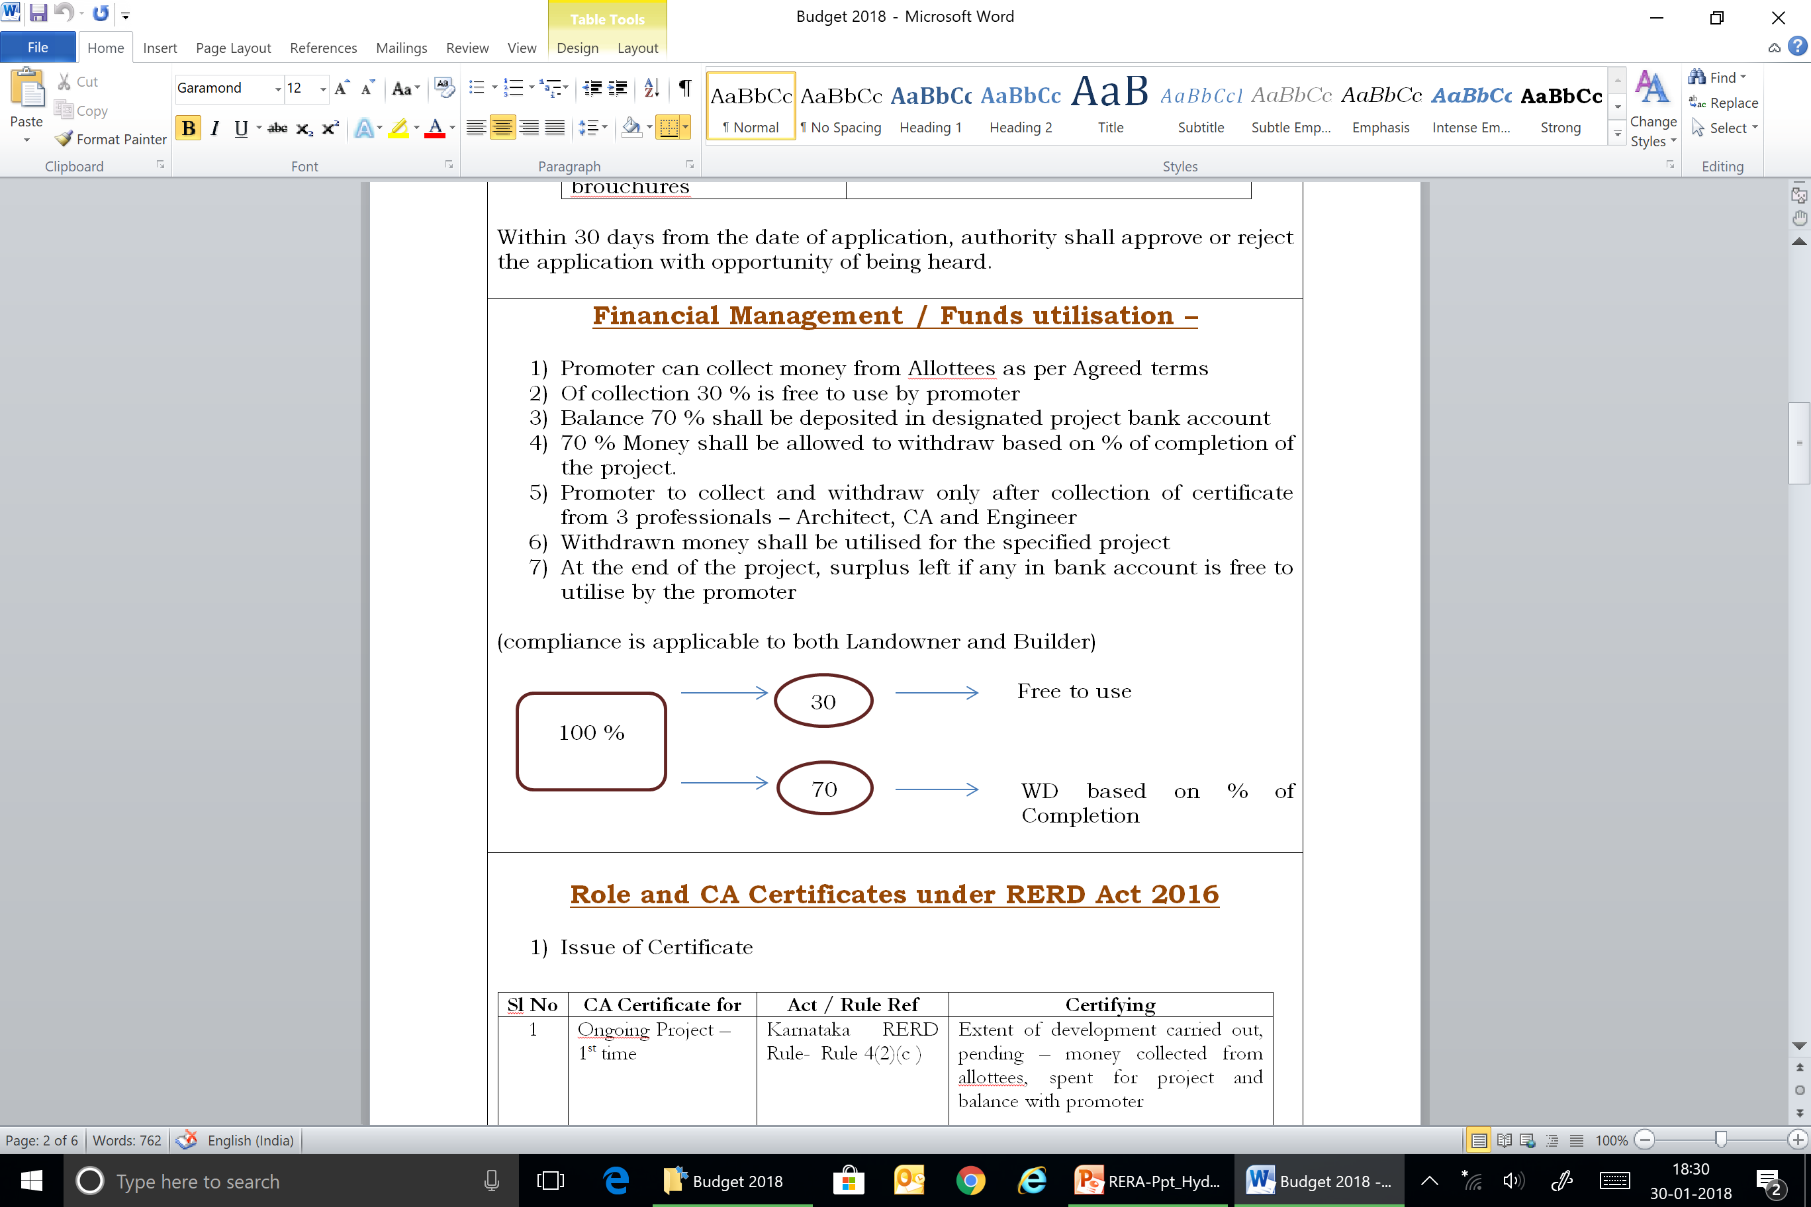
Financial Management / Funds utilisation
Promoter can collect money from Allottees as per Agreed terms
Out of collection 30 % is free to use by promoter
Balance 70 % shall be deposited in designated project bank account
70 % Money shall be allowed to withdraw based on % of completion of the project.
Promoter to collect and withdraw only after collection of certificate from 3 professionals – Architect, CA and Engineer
Withdrawn money shall be utilised for the specified project
At the end of the project, surplus left if any in bank account is free to utilise by the promoter (compliance is applicable to both Landowner and Builder)

Slide 35
Post RERA – Business Cycle
1 – Due Diligence of Land and Project
2 – Feasibility of the Project / Market Study etc
3 – Enter MOU with Land Owner
4 – DA / JDA / GPA
5- Apply for Noc’ clearances
6 – Sanction Plans
7 – PREAPRE ALL DOC FOR RERA APPLICATION
8 – RERA REGISTRATION
9 – LAUNCH / ADVERTISEMENT ETC

Slide 36
Post RERA – Customer Transactions
1 - Booking Form
2 - Allotment Letter
3 - Enter Agreement for Sale
4 - Register Agreement for Sale – if promoter collects > 10 % of total cost
5- Formation of Association of Allottees once majority of units are booked
6 - Complete development and
Obtain OC
7 - Conveyance deed within 3 months of OC
8 – Title Insurance / Defect Liability for 5 years
9 – Handover to Association

Slide 37
Critical aspects to be considered while filing the applications for grant of Registration
Promoter Details – KYC, Background, Financial Statements
Land Details – Ownership, Development Agreement, Revenue Records
Sanction Plan – Issued by planning authority – shall have validity
NOC’s – Various NOC’s – AAI, Electricity, Fire, Water, Road, Rail…
Affidavit – Form B – very important document
Specification / Technical Specification – very critical and be clear on deliverables
Legal Drafts – allotment letter, Agreement, Sale Deed – As per RERA
Estimated Cost of Project – Land and Development
Project Bank Account – Designated Bank Account for the Project
Start date and End Date – Considering the past experience and various factors
Other details – Litigation, Area Statement, professional details, other details

Slide 38
Professional - Reference in the Act – Sec 4(2)(l)(D)
that seventy per cent. of the amounts realised for the real estate project from the allottees, from time to time, shall be deposited in a separate account to be maintained in a scheduled bank to cover the cost of construction and the land cost and shall be used only for that purpose
Provided that the promoter shall withdraw the amounts from the separate account, to cover the cost of the project, in proportion to the percentage of completion of the project
Provided further that the amounts from the separate account shall be withdrawn by the promoter after it is certified by an engineer, an architect and a chartered accountant in practice that the withdrawal is in proportion to the percentage of completion of the project
Provided also that the promoter shall get his accounts audited within six months after the end of every financial year by a chartered accountant in practice, and shall produce a statement of accounts duly certified and signed by such chartered accountant and it shall be verified during the audit that the amounts collected for a particular project have been utilised for the project and the withdrawal has been in compliance with the proportion to the percentage of completion of the project.

Slide 39
Penalties
If any promoter does not comply with the orders, decisions or directions issued or violate the provisions of registration - punishable with imprisonment upto 3 years or with fine upto 10% of the estimated cost of the project, or with both.
If any promoter provides false information or contravenes the provisions of registration of real estate projects - penalty upto 5% of the estimated cost of the project.
If any promoter contravenes the provisions of registration - liable to penalty upto 10% of the estimated cost of project as determined by the Authority.
If any promoter contravenes any other provisions of the Real Estate Act - penalty upto 5% of the estimated cost of the project as determined by the Authority

Slide 40
Operational Transformation
Superior Project Management
Cohesive approach across departments – Sales, Finance, Marketing and Contracts
Project development
– Cash flow planning
Increase in sales efficiency
The Real Estate (Regulations & Development) Act, 2016
Impact on business model/ Partners
Design Management
Awareness | Change & Readiness | Discipline | Monitoring
Identifying key stakeholders
Impact Analysis, Workshops and discussions
Conducting health check | Changes to process
Changes to ERP Compliance focused | Co-ordinated approach across functions
Changes to control environment
MIS and score cards
Performance Management

Slide 41

CA.Vinay Thyagaraj
Bengaluru
vinay@vnv.ca

